Slide 1

Unit 4: Lesson 5 Two masterpieces

Slide 2
Task 1: What is a masterpiece?
Task 2: Complete the description with the words below.
painted
created
colours
shades
writers
steel
shape
calm
modern
location

Slide 3
Task 3: Choose one of the masterpieces and answer the questions.

Slide 4
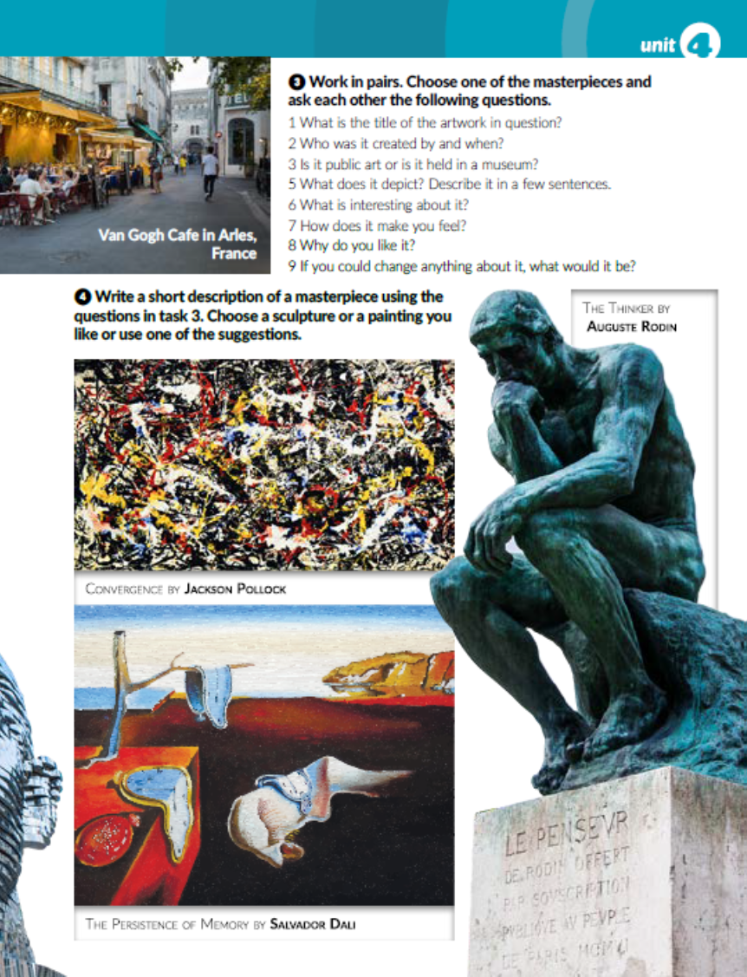
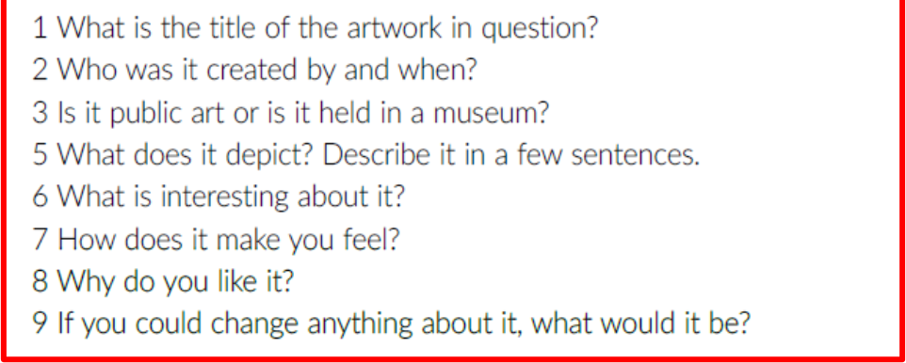
Task 4: Choose one of the masterpieces in pictures and describe it using the questions in task 3.

Slide 5
7
workbook, page 79
Task 1: Match the pictures to the descriptions.
6
1
3
4
5
2
8

Slide 6
Task 2 : Read the description of the famous sculpture in the picture and correct the mistakes. Rewrite the description.
The Winged Nike or The Winged Victory of Samothrace is a famous Greek sculpture that was created in the 2nd century BC. The author of the sculpture is unknown. The sculpture is made of marble and displayed at the famous Louvre museum in Paris which is visited by thousands of people every day. It is one of rare sculptures that survived in its original form, apart from the right wing, which isn't original, and was added by mirroring the left wing. The sculpture is 244 centimetres high and it was created to honour Nike, the Greek goddess of victory. Historians believe it depicts the moment when Nike triumphantly lands on the victory ship after a successful sea battle. What makes the sculpture so amazing is the lightness of the fabric that drapes around her body as if it wasn’t made from stone. The image is so powerful that you can almost feel the wind coming from her wings as she descends from hights. There is something poetic, breath-taking and timeless about it. No wonder it was used as an inspiration for one of the most famous sport logos in the world.

Slide 7

LEARN MORE!
https://www.e-sfera.hr/dodatni-digitalni-sadrzaji/88e6e1b0-40d2-427d-8403-534e5da11132/

